Slide 1



PROJECT ON
Laptop Data analysis
Presented by:
M.SHARATH KUMAR
BATCH No: 450
Branch: Dilsukhnagar

Slide 2
About me
I am MORANGAPALLI SHARATH KUMAR
I completed my graduation in the stream of B.sc(MSDS) and Degree from Govt degree college of Khairatabad.
LinkedIn: https://www.linkedin.com/feed/?trk=guest_homepage-basic_google-one-tap-submit
Github: https://github.com/morangapallysharathkumar?tab=repositories

Slide 3
Agenda
Problem Statement
Objective
Dataset Overview
Data Extraction
Univariate Analysis
Bivariate Analysis
Multivariate Analysis
Hypothesis Testing
Major Findings from Laptop Data Analysis

Slide 4

Problem Statement
The Core Challenge: Consumers and stakeholders often find it difficult to determine whether a laptop's price is justified by its performance or simply influenced by its brand name.
Primary Research Problems:
Brand Impact: * Determining if the brand name significantly inflates the price regardless of the hardware provided.
  Identifying if "Brand Premium" outweighs technical value.
Technical Influence: * Identifying which specific specifications (RAM, ROM, Processor) have the highest correlation with cost.

Slide 5
Objective
Project Goal: To perform an Exploratory Data Analysis (EDA) that quantifies the relationship between brand identity and technical specifications, helping stakeholders identify which factors contribute most to the laptop's valuation.

Slide 6
Data Extraction
The Tool: I used Selenium.
The Process:
The script opens Chrome automatically.
It "clicks buttons" to load all the images.
It finds specific "tags" in the website's code to pull out the prices.
Result: I extracted [534 rows & 12 columns]

Slide 7
Dataset Overview
Dataset Summary
Total Records: 534 unique laptop listings.
Total Columns: 12 attributes covering specifications and pricing.
Core Attributes
Categorical: Brand (Apple, HP, Asus, etc.), Processor Type, Model Name, and Color.
Physical Specs: Screen Size (inches) and Weight (KG).
Hardware Specs: RAM (GB) and Storage Capacity (ROM GB).
Financial Metrics: Current Price, Original Price, Savings (INR), and Discount Percentage.

Slide 8
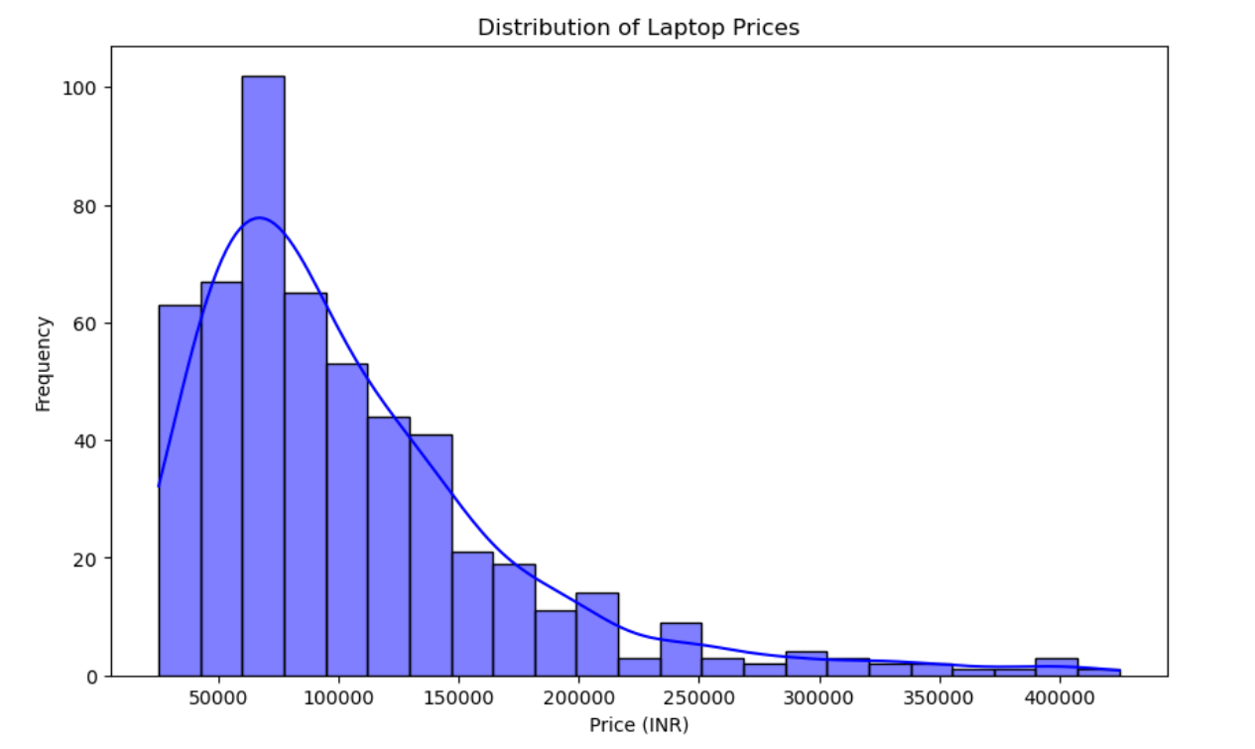
Univariate Analysis
1. Price Distribution (Are these budget or luxury laptops?)

Slide 9
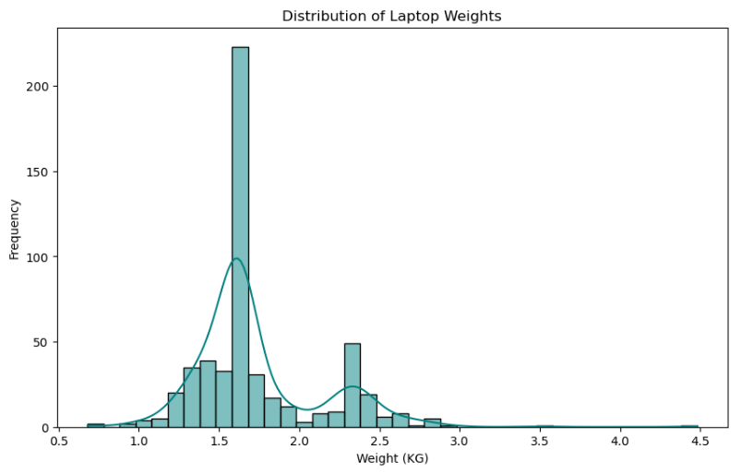
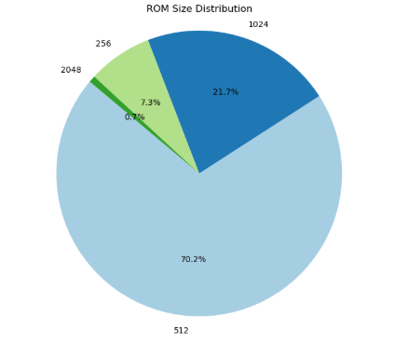
Distributions

Slide 10
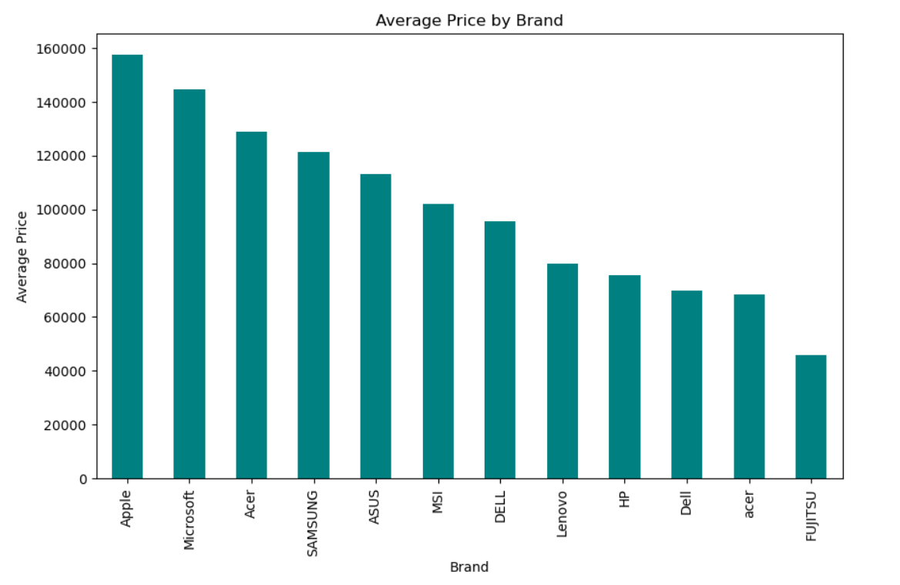
Bivariate Analysis
Brand vs. Average Price (Which brand is most expensive?)

Slide 11
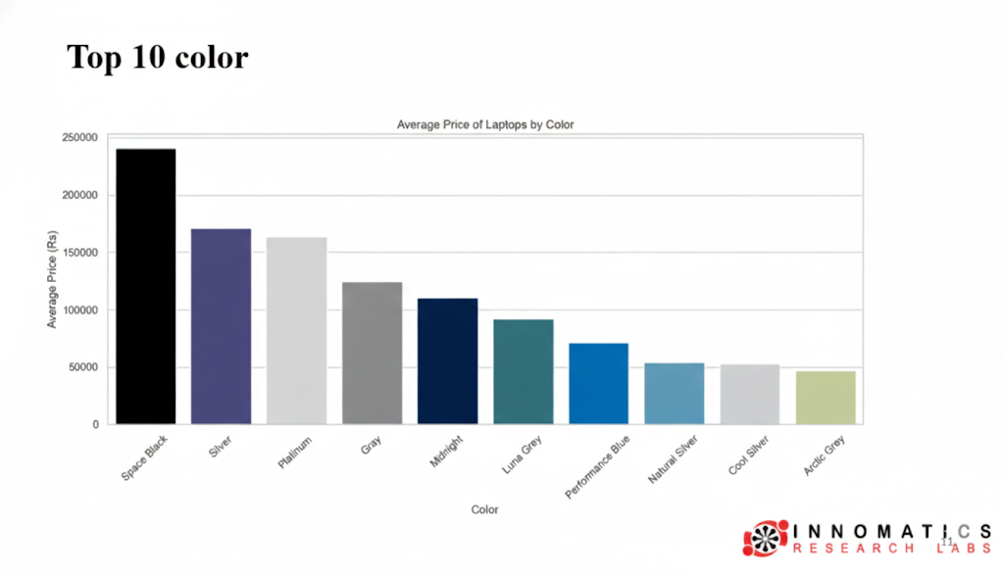

Slide 12
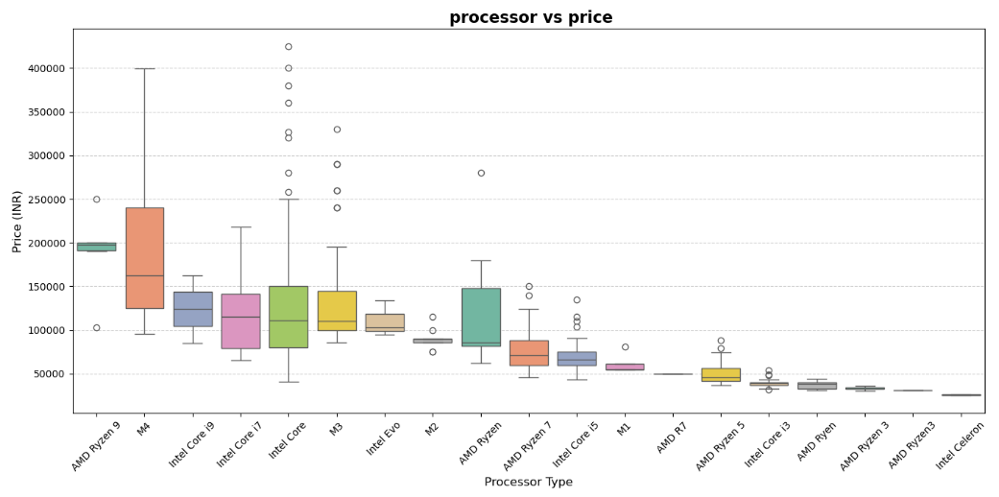
How Processor Choice Impacts Laptop Price

Slide 13
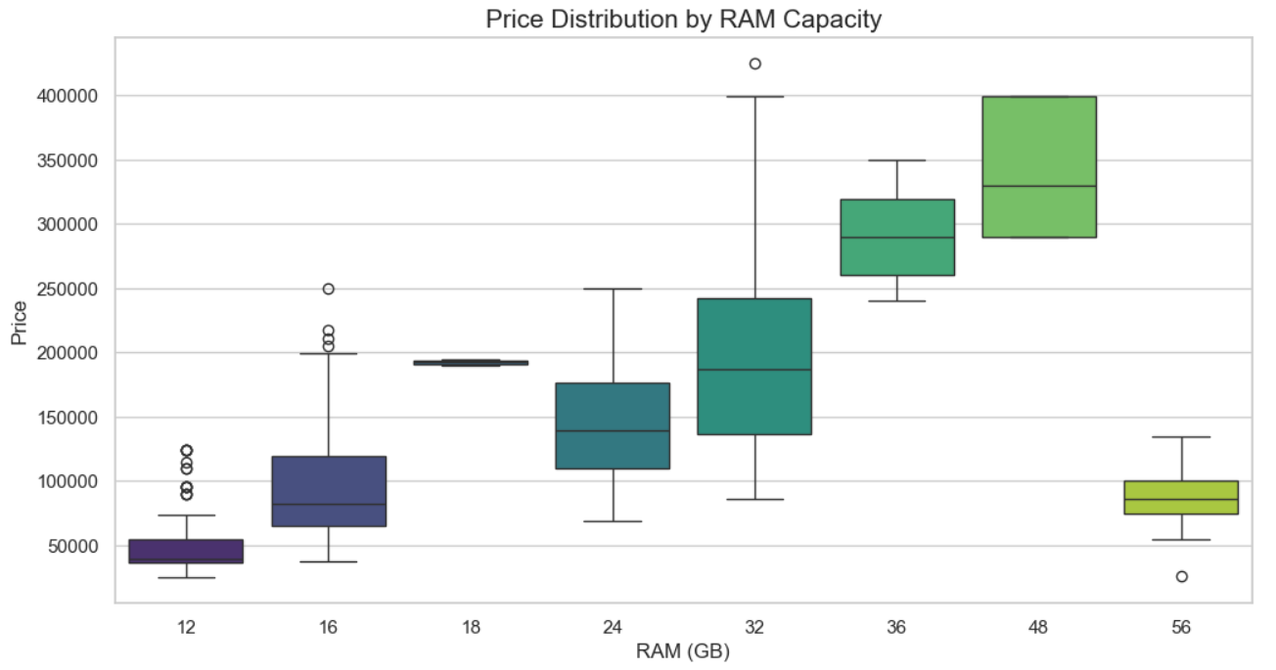
RAM vs. Price (How much does extra memory cost?)

Slide 14
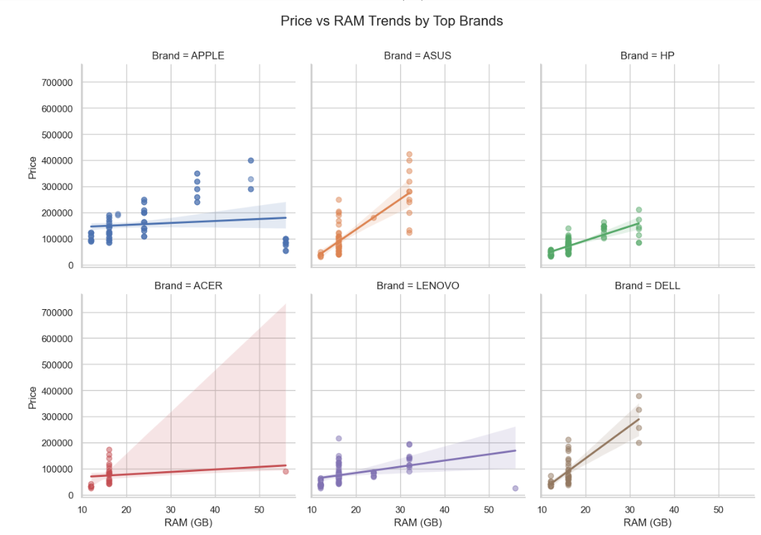

Slide 15
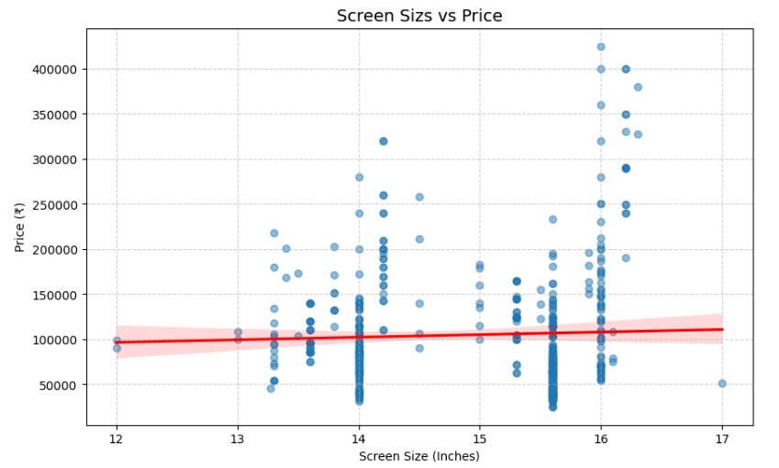
Screen Size vs Price: Larger Screens show a Slight Price Increase

Slide 16
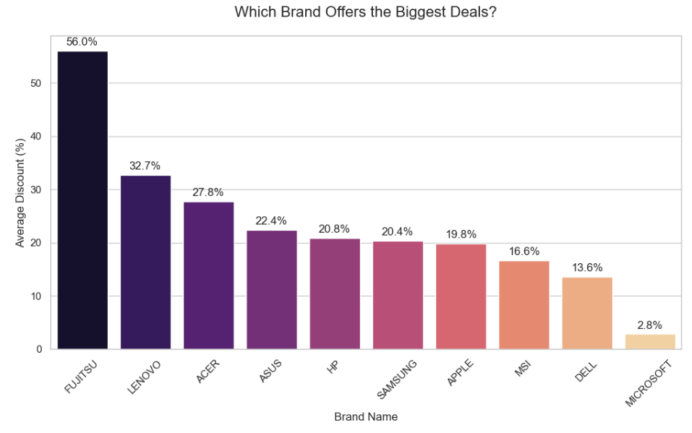
Discount Analysis (Which brand offers the biggest deals?)¶

Slide 17
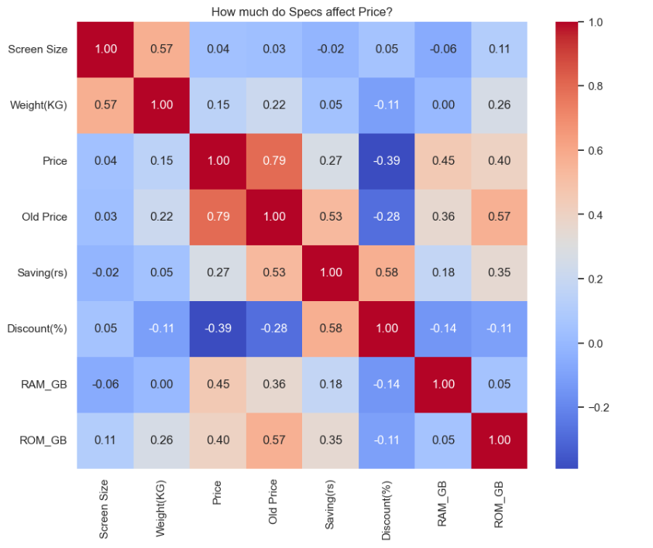
Multivariate Analysis
To check which features (RAM, ROM, Weight, Screen Size) have the strongest "pull" on the price.

Slide 18
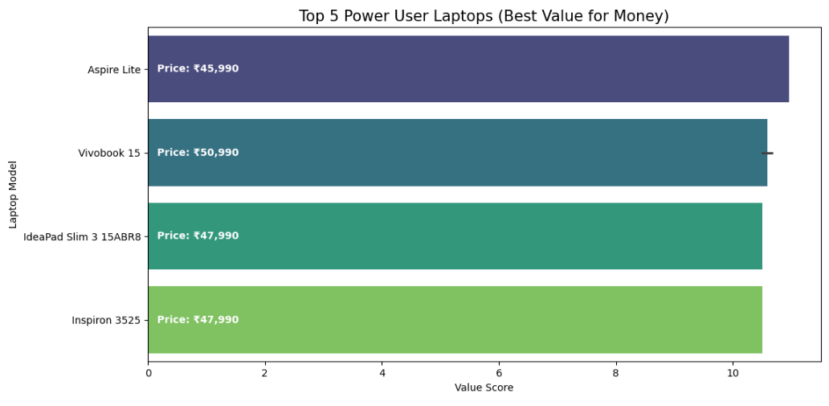
The "Power User" (High Specs, Mid Price)

Slide 19
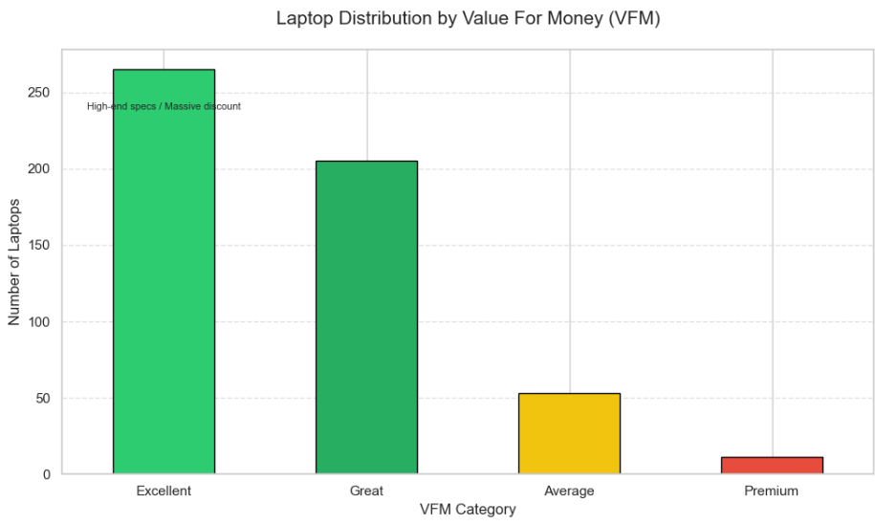

Slide 20
VFM Score, Category & Business Meaning
9.0 - 10.0 --> Excellent
High-end specs at a budget price; likely a massive discount.
7.0 - 8.9 --> Great
Solid hardware for a very fair market price.
5.0 - 6.9 --> Average
Standard pricing; you get exactly what you pay for.
Below 5.0 --> Premium
"You are paying for the Brand name, build quality, or thinness."

Slide 21
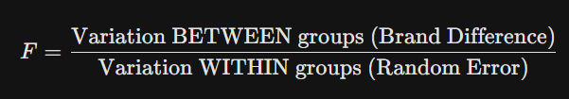
Hypothesis Testing
Null Hypothesis (H0): The average price is the same for all brands. (Brand doesn't matter).
Alternative Hypothesis (H1): At least one brand has a significantly different average price compared to the others
Test used: One-Way ANOVA :
F-statistic: 18.435729091618313
p-value: 0.000000000000000000000002044

Slide 22
Summary for the test case:
Rule: If p < 0.05, we reject the Null Hypothesis.
High F-score shows significant brand differences.
Near-zero p-value proves results are real.
Rejected Null Hypothesis; Brand name matters.
Statistical data confirms brand price variation.
Finding: Confirmed that the "Brand" factor is statistically significant ().
Observation: Brands like Apple and Microsoft have a higher "Brand Premium" compared to Acer and HP, which target the budget-friendly segment.

Slide 23
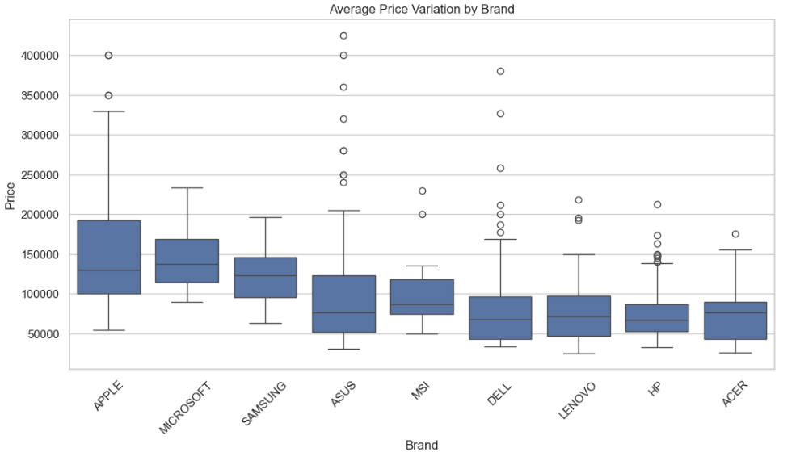

Slide 24
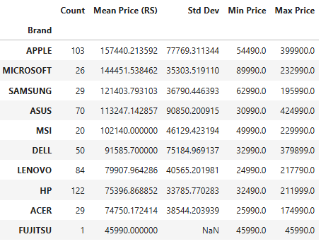
Descriptive Data for Brands

Slide 25
Major Findings from Laptop Data Analysis
1. Brand Dominance & Price Premium
High-Tier Brands: Apple and Microsoft lead the market with the highest average prices (₹1.57L and ₹1.44L respectively), confirming a significant "Brand Premium."
Budget Competitors: Brands like Fujitsu and Acer offer the lowest average entry points, focusing on price-sensitive consumers.
2. Technical Drivers of Value
RAM is King: Performance specs show a moderate positive correlation (0.45) with price, indicating that RAM capacity is a stronger price driver than storage (ROM) or screen size.
Storage Impact: ROM_GB also significantly influences cost (0.40 correlation), while physical attributes like weight and screen size have a negligible impact on pricing.

Slide 26
3. Discounting Strategies
Aggressive Discounting: Fujitsu (56%) and Lenovo (32%) use the highest average discounts to drive sales.
Price Stability: Microsoft maintains the lowest average discount (~2.8%), suggesting a "fixed-price" premium strategy compared to competitors who fluctuate prices often.
4. Statistical Summary for Price by Brand
The data reveals a clear segmentation: Premium brands maintain high prices with low discounts, while mid-tier brands (HP, Acer) rely heavily on "Savings (rs)" to attract buyers.

Slide 27
Conclusion
Selenium successfully scraped 534 laptop listings.
Brand identity significantly drives market pricing.
Apple and Microsoft command highest premiums.
RAM is the leading technical driver.
Storage shows moderate correlation with cost.
Discounts fluctuate based on brand strategy.

Slide 28
Q & A

Slide 29

THANK YOU

